Slide 1

Greedy Approach
Design and Analysis of
Algorithms
Rajesh Kumar Tripathi
Assistant Professor, Dept. CEA

Slide 2
Greedy Approach
A Greedy Approach obtains an optimal solution by making a sequence of choices.
-- A Greedy algorithm always makes the choice that looks best at the
moment.
-- it makes a locally optimal choice in the hope that this choice will lead to
a globally optimal solution

Slide 3
Greedy Approach
Greedy algorithms do not always yield optimal solution.
-- Fractional Knapsack
-- Minimum Spanning Trees-Prim and Kruskal
-- Single source shortest paths- Dijkstra and Bellman ford
-- Convex Hull and Searching
-- Activity selection problem
-- Designing data compression codes (Huffman)

Slide 4
Activity Selection Problem
S={a₁, a₂, a₃, ……….., a_{n}} of n proposed activities that wish to use a resource, such as lecture hall, which can serve only one activity at a time.
Each activity ai has start time si and fi finish time where 0<=s_{i}<=f_{i}<=infinity,
If selected activity ai takes place during half open time interval [s_{i}, f_{i}). Activities a_{i} & a_{j} are compatible if the intervals [s_{i},f_{i}) and [s_{j}, f_{j}) do not overlap.
a_{i} and a_{j} are compatible if s_{i}>=s_{j} or s_{j}>=f_{i}
Activites are sorted in monotonically increasing order of finish time- f₁<=f₂<=f₃<=f₄<=……………….<=f_{n-1}<=f_{n}.

Slide 5
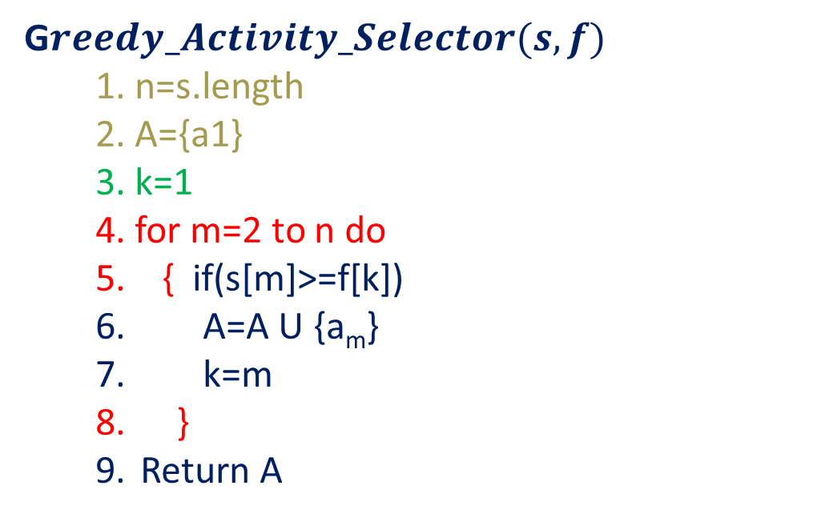
Activity Selection Problem
G$reedy_Activity_Selector(s,f)$
1. n=s.length
2. A={a1}
3. k=1
4. for m=2 to n do
5. { if(s[m]>=f[k])
A=A U {a_{m}}
k=m
}
Return A
1 | 2 | 3 | 4 | 5 | 6 | 7 | 8 | 9 | 10 | 11
s_{i}
1 | 3 | 0 | 5 | 3 | 5 | 6 | 8 | 8 | 2 | 12
4 | 5 | 6 | 7 | 9 | 9 | 10 | 11 | 12 | 14 | 16
f_{i}

Slide 6
Activity Selection Problem
G$reedy_Activity_Selector(s,f)$
1. n=s.length
2. A={a1}
3. k=1
4. for m=2 to n do
5. { if(s[m]>=f[k])
A=A U {a_{m}}
k=m
}
Return A
N=11
1 | 2 | 3 | 4 | 5 | 6 | 7 | 8 | 9 | 10 | 11
s_{i}
1 | 3 | 0 | 5 | 3 | 5 | 6 | 8 | 8 | 2 | 12
4 | 5 | 6 | 7 | 9 | 9 | 10 | 11 | 12 | 14 | 16
f_{i}

Slide 7
Activity Selection Problem
G$reedy_Activity_Selector(s,f)$
1. n=s.length
2. A={a1}
3. k=1
4. for m=2 to n do
5. { if(s[m]>=f[k])
A=A U {a_{m}}
k=m
}
Return A
a_{i}
1 | 2 | 3 | 4 | 5 | 6 | 7 | 8 | 9 | 10 | 11
N=11
s_{i}
1 | 3 | 0 | 5 | 3 | 5 | 6 | 8 | 8 | 2 | 12
4 | 5 | 6 | 7 | 9 | 9 | 10 | 11 | 12 | 14 | 16
A={a1}
f_{i}
K=1
M=2 to 11
M=2 s[2]>=f[1] false m++ i.e. m=3
M=3, k=1 s[3]>=f[1] false m++ i.e. m=4
M=4, k=1 s[4]>=f[1] yes
A={a1, a4}
k=m i.e. k=4 m++ i.e. m=5
M=5, k=4 s[5]>=f[4] false m++ i.e. m=6
M=6, k=4 s[6]>=f[4] false m++ i.e. m=7
M=7, k=4 s[7]>=f[4] false m++ i.e. m=8
M=8, k=4 s[8]>=f[4] yes
A={a1, a4, a8} k=m i.e. k=8 and m=9
M=9, k=8 s[9]>=f[8] false m++ i.e. m=10
M=10, k=8 s[10]>=f[8] false m++ i.e. m=11
M=11, k=8 s[11]>=f[8] yes A={a1, a4, a8, a11)

Slide 8
Activity Selection Problem
G$reedy_Activity_Selector(s,f)$
1. n=s.length
2. A={a1}
3. k=1
4. for m=2 to n do
5. { if(s[m]>=f[k])
A=A U {a_{m}}
k=m
}
Return A
a_{i}
1 | 2 | 3 | 4 | 5 | 6 | 7 | 8 | 9 | 10 | 11
N=11
s_{i}
1 | 3 | 0 | 5 | 3 | 5 | 6 | 8 | 8 | 2 | 12
4 | 5 | 6 | 7 | 9 | 9 | 10 | 11 | 12 | 14 | 16
A={a1}
f_{i}
K=1
M=2 to 11
M=2 s[2]>=f[1] false m++ i.e. m=3
M=3, k=1 s[3]>=f[1] false m++ i.e. m=4
M=4, k=1 s[4]>=f[1] yes
A={a1, a4}
k=m i.e. k=4 m++ i.e. m=5
M=5, k=4 s[5]>=f[4] false m++ i.e. m=6
M=6, k=4 s[6]>=f[4] false m++ i.e. m=7
M=7, k=4 s[7]>=f[4] false m++ i.e. m=8
M=8, k=4 s[8]>=f[4] yes
A={a1, a4, a8} k=m i.e. k=8 and m=9
M=9, k=8 s[9]>=f[8] false m++ i.e. m=10
M=10, k=8 s[10]>=f[8] false m++ i.e. m=11
M=11, k=8 s[11]>=f[8] yes A={a1, a4, a8, a11)

Slide 9
Activity Selection Problem
G$reedy_Activity_Selector(s,f)$
1. n=s.length
2. A={a1}
3. k=1
4. for m=2 to n do
5. { if(s[m]>=f[k])
A=A U {a_{m}}
k=m
}
Return A
a_{i}
1 | 2 | 3 | 4 | 5 | 6 | 7 | 8 | 9 | 10 | 11
N=11
s_{i}
1 | 3 | 0 | 5 | 3 | 5 | 6 | 8 | 8 | 2 | 12
4 | 5 | 6 | 7 | 9 | 9 | 10 | 11 | 12 | 14 | 16
A={a1}
f_{i}
K=1
M=2 to 11
M=2
s[2]>=f[1] false
m++ i.e.
m=3

Slide 10
Activity Selection Problem
G$reedy_Activity_Selector(s,f)$
1. n=s.length
2. A={a1}
3. k=1
4. for m=2 to n do
5. { if(s[m]>=f[k])
A=A U {a_{m}}
k=m
}
Return A
a_{i}
1 | 2 | 3 | 4 | 5 | 6 | 7 | 8 | 9 | 10 | 11
N=11
s_{i}
1 | 3 | 0 | 5 | 3 | 5 | 6 | 8 | 8 | 2 | 12
4 | 5 | 6 | 7 | 9 | 9 | 10 | 11 | 12 | 14 | 16
A={a1}
f_{i}
K=1
M=3 to 11
M=3,
k=1
s[3]>=f[1] false
m++ i.e. m=4

Slide 11
Activity Selection Problem
G$reedy_Activity_Selector(s,f)$
1. n=s.length
2. A={a1}
3. k=1
4. for m=2 to n do
5. { if(s[m]>=f[k])
A=A U {a_{m}}
k=m
}
Return A
a_{i}
1 | 2 | 3 | 4 | 5 | 6 | 7 | 8 | 9 | 10 | 11
N=11
s_{i}
1 | 3 | 0 | 5 | 3 | 5 | 6 | 8 | 8 | 2 | 12
4 | 5 | 6 | 7 | 9 | 9 | 10 | 11 | 12 | 14 | 16
A={a1}
f_{i}
K=1
M=4 to 11
M=4,
k=1
s[4]>=f[1] yes
A={a1, a4}
k=m i.e. k=4 m++ i.e. m=5

Slide 12
Activity Selection Problem
G$reedy_Activity_Selector(s,f)$
1. n=s.length
2. A={a1}
3. k=1
4. for m=2 to n do
5. { if(s[m]>=f[k])
A=A U {a_{m}}
k=m
}
Return A
a_{i}
1 | 2 | 3 | 4 | 5 | 6 | 7 | 8 | 9 | 10 | 11
N=11
s_{i}
1 | 3 | 0 | 5 | 3 | 5 | 6 | 8 | 8 | 2 | 12
4 | 5 | 6 | 7 | 9 | 9 | 10 | 11 | 12 | 14 | 16
A={a1}
f_{i}
K=1
M=5 to 11
M=5,
k=4
s[5]>=f[4] false
m++ i.e. m=6

Slide 13
Activity Selection Problem
G$reedy_Activity_Selector(s,f)$
1. n=s.length
2. A={a1}
3. k=1
4. for m=2 to n do
5. { if(s[m]>=f[k])
A=A U {a_{m}}
k=m
}
Return A
a_{i}
1 | 2 | 3 | 4 | 5 | 6 | 7 | 8 | 9 | 10 | 11
N=11
s_{i}
1 | 3 | 0 | 5 | 3 | 5 | 6 | 8 | 8 | 2 | 12
4 | 5 | 6 | 7 | 9 | 9 | 10 | 11 | 12 | 14 | 16
A={a1}
f_{i}
K=1
M=6 to 11
M=6,
k=4
s[6]>=f[4] false
m++ i.e. m=7

Slide 14
Activity Selection Problem
G$reedy_Activity_Selector(s,f)$
1. n=s.length
2. A={a1}
3. k=1
4. for m=2 to n do
5. { if(s[m]>=f[k])
A=A U {a_{m}}
k=m
}
Return A
a_{i}
1 | 2 | 3 | 4 | 5 | 6 | 7 | 8 | 9 | 10 | 11
N=11
s_{i}
1 | 3 | 0 | 5 | 3 | 5 | 6 | 8 | 8 | 2 | 12
4 | 5 | 6 | 7 | 9 | 9 | 10 | 11 | 12 | 14 | 16
A={a1}
f_{i}
K=1
M=7 to 11
M=7,
k=4
s[7]>=f[4] false
m++ i.e. m=8

Slide 15
Activity Selection Problem
G$reedy_Activity_Selector(s,f)$
1. n=s.length
2. A={a1}
3. k=1
4. for m=2 to n do
5. { if(s[m]>=f[k])
A=A U {a_{m}}
k=m
}
Return A
a_{i}
1 | 2 | 3 | 4 | 5 | 6 | 7 | 8 | 9 | 10 | 11
N=11
s_{i}
1 | 3 | 0 | 5 | 3 | 5 | 6 | 8 | 8 | 2 | 12
4 | 5 | 6 | 7 | 9 | 9 | 10 | 11 | 12 | 14 | 16
A={a1}
f_{i}
K=1
M=8 to 11
M=8,
k=4 s[8]>=f[4] yes
A={a1, a4, a8}
k=m i.e. k=8 and m=9

Slide 16
Activity Selection Problem
G$reedy_Activity_Selector(s,f)$
1. n=s.length
2. A={a1}
3. k=1
4. for m=2 to n do
5. { if(s[m]>=f[k])
A=A U {a_{m}}
k=m
}
Return A
a_{i}
1 | 2 | 3 | 4 | 5 | 6 | 7 | 8 | 9 | 10 | 11
N=11
s_{i}
1 | 3 | 0 | 5 | 3 | 5 | 6 | 8 | 8 | 2 | 12
4 | 5 | 6 | 7 | 9 | 9 | 10 | 11 | 12 | 14 | 16
A={a1}
f_{i}
K=1
M=9 to 11
M=9,
k=8
s[9]>=f[8] false
m++ i.e. m=10

Slide 17
Activity Selection Problem
G$reedy_Activity_Selector(s,f)$
1. n=s.length
2. A={a1}
3. k=1
4. for m=2 to n do
5. { if(s[m]>=f[k])
A=A U {a_{m}}
k=m
}
Return A
a_{i}
1 | 2 | 3 | 4 | 5 | 6 | 7 | 8 | 9 | 10 | 11
N=11
s_{i}
1 | 3 | 0 | 5 | 3 | 5 | 6 | 8 | 8 | 2 | 12
4 | 5 | 6 | 7 | 9 | 9 | 10 | 11 | 12 | 14 | 16
A={a1}
f_{i}
K=1
M=10 to 11
M=10,
k=8
s[10]>=f[8] false
m++ i.e. m=11

Slide 18
Activity Selection Problem
G$reedy_Activity_Selector(s,f)$
1. n=s.length
2. A={a1}
3. k=1
4. for m=2 to n do
5. { if(s[m]>=f[k])
A=A U {a_{m}}
k=m
}
Return A
a_{i}
1 | 2 | 3 | 4 | 5 | 6 | 7 | 8 | 9 | 10 | 11
N=11
s_{i}
1 | 3 | 0 | 5 | 3 | 5 | 6 | 8 | 8 | 2 | 12
4 | 5 | 6 | 7 | 9 | 9 | 10 | 11 | 12 | 14 | 16
A={a1}
f_{i}
K=1
M=11 to 11
M=11,
k=8
s[11]>=f[8] yes
A={a1, a4, a8, a11)

Slide 19
Activity Selection Problem
G$reedy_Activity_Selector(s,f)$
1. n=s.length
2. A={a1}
3. k=1
4. for m=2 to n do
5. { if(s[m]>=f[k])
A=A U {a_{m}}
k=m
}
Return A
N=11
A={a1}
K=1
M=11 to 11
Complexity of Fractional Knapsack
?

Slide 20
Thank You

